Slide 1
PRUNING NEURAL NETWORKS: LOTTERY TICKET APPROACH
by
Group-8
Himakar Sai Chowdary Maddipati
Harshit Kumawat
Garvit Katyal
Jayshil Patel
Rushil Kumar
Samik Pal

Slide 2
Literature Survey
The following papers are studied.
1.THE LOTTERY TICKET HYPOTHESIS:FINDING SPARSE, TRAINABLE NEURAL NETWORKS
- Jonathan Frankl,Michael Carbin
2.Deconstructing Lottery Tickets: Zeros, Signs, and the Super mask
- Hattie Zhou, Janice Lan, Rosanne Liu,Jason Yosinski
3.What’s Hidden in a Randomly Weighted Neural Network?
- Vivek Ramanujan, Mitchell Wortsman, Aniruddha,
Kembhavi,Ali Farhadi ,Mohammad Rastegari
4.Understanding the difficulty of training deep feed forward neural networks
-Xavier Glorot Yoshua Bengio
5.PRUNING CONVOLUTIONAL NEURAL NETWORKS FOR RESOURCE EFFICIENT
INFERENCE -Pavlo Molchanov, Stephen Tyree, Tero Karras,
Timo Aila, Jan Kautz
6.PRUNING FILTERS FOR EFFICIENT CONVNETS
-Hao Li, Asim Kadav, Igor Durdanovic, Hanan Samet,
Hans Peter Graf

Slide 3
Paper1
THE LOTTERY TICKET HYPOTHESIS:FINDING SPARSE TRAINABLE
NEURAL NETWORKS
Jonathan Frankl, Michael Carbin
Rational :reduce the parameter counts, decreasing storage requirements, and
improving computational performance of inference ,without compromising accuracy.
Hypothesis : dense, randomly-initialized, feed-forward networks contain sub networks
(winning tickets) that—when trained in isolation—reach test accuracy comparable to
the original network in a similar number of iterations.
Datasets:MNIST,CIFAR-10
networks: Le net ,Conv-2,Conv-4 ,Conv-6, Resnet-18 ,VGG-19

Slide 4
Paper1.Methodology to find winning sub networks:
A . One-shot Pruning:
Randomly initialize a neural network parameters as θ_{0.}
Train the network for j iterations, arriving at new parameters θ_{j}.
Prune p% of the parameters in θ_{j}, creating a mask=m(keep high value weights).
4. Reset the remaining parameters to their initial values in θ₀,calculate accuracies
to find winning sub network
B . Iterative Pruning:
The above procedure repeated for n iterations, p^{1/n}% parameters of the previous
iteration are pruned. RESULTS:
Network | Lenet | Conv-2 | Conv-4 | Conv-6 | Resnet-18 | VGG-19
Convolutions |  | 64, 64, pool | 64, 64, pool 128,128,pool | 64, 64, pool 128,128,pool 256,256,pool | 64 2x[64,64] 2x[128,128] 2x[256,256] 2x[512,512] | 2x64 pool 2x128pool, 4x256, pool 4x512, pool, 4x512
FC Layers | 300,100,10 | 256, 256,10 | 256, 256, 10 | 256, 256, 10 | avg-pool, 10 | avg-pool, 10
All/Conv Weights | 266K | 4.3M / 38K | 2.4M / 260K | 1.7M / 1.1M | 274K / 270K | 20.0M
Iterations/Batch | 50K / 60 | 20K / 60 | 25K / 60 | 30K / 60 | 30K / 128 | 112K / 64
Optimizer | Adam 1.2e-3 | Adam 2e-4 | Adam 3e-4 | Adam 3e-4 | ←SGD 0.1-0.01-0.001 | Momentum 0.9→
Winning sub network Pruning Rate | fc20% | conv10% fc20% | conv10% fc20% | conv15% fc20% | conv20% fc0% | conv20% fc0%

Slide 5
Paper2
Deconstructing Lottery Tickets: Zeros, Signs, and the Super mask
Hattie Zhou, Janice Lan, Rosanne Liu,Jason Yosinski
Rational : Zeros, Signs, and the Super mask explain performance improvement of
Lottery Ticket Algorithm
Hypothesis: Study the effects of Zeros, Signs, and the Super mask on Lottery Ticket
algorithm.
Datasets:MNIST,CIFAR-10
networks: FC ,Conv-2,Conv-4 ,Conv-6

Slide 6
Paper2 Methodology I
Initialize a mask m to all ones. Randomly initialize the parameters w of a network
Train the parameters w of the network to completion. (initial weights=w_{i} and weights after
training =w_{f} ).
2.Choose one Mask Criteria to keep Weights: large final (|w_{f}|),small final (-|w_{f}|), large init (|w_{i}|),
small init (-|w_{i}|), min(large init; large final), -max(small init ;small final),
Magnitude increase(|w_{f}|-|w_{i}|),Movement (|w_{f}-w_{i}|),random
3. Mask Criterion: set the mask value for the top p% to 1, the bottom (100-p)% to 0 as proposed in original paper on Lottery Tickets.
4. Mask-1 Action: The weights with mask value 1 are studied for three methods as follows:
a. reset to their initial values
b. set after reshuffling the initial weights
c. set to signed constant (+S.D,0,-S.D)of of original values
5. Mask-0 Action: The weights with mask value 0,were pruned: set to 0 and frozen
during any subsequent training.
6. Repeat from 1 if performing iterative pruning
Methodology II: Same as Methodology I Except with step3 and step6 as below
Super masks
Step3: apply large_final masks to weights.
Step6:Test accuracy of pruned network without actual training.
Optimizing the Super mask:(Apply stochasticity to masks)
Methodology III: Same as Methodology II Except with step3 as below
Dynamic Weight Rescaling: multiply the underlying large_final masks weights by the ratio of the total number of weights in the layer over the number of ones in the corresponding mask.

Slide 7
Paper2 Results:
Test Accuracy
MASK | INIT | S.C | SUPERMASK INIT | SUPERMASK S.C | DWR INIT | DWR S.C | TRAINED
MNIST FC | 79.3 | 86.3 | 95.3 | 96.4 | 97.8 | 98.0 | 97.7
CIFAR CONV2 | 22.3 | 37.4 | 64.4 | 66.3 | 65.0 | 66.0 | 69.2
CIFAR CONV4 | 23.7 | 39.7 | 65.4 | 66.2 | 71.7 | 72.5 | 75.4
CIFAR CONV6 | 24.0 | 41.0 | 65.3 | 65.4 | 76.3 | 76.5 | 78.3
Init= set retained weights to initial values
S.C=signed constant =set retained weights to one of (+S.D,0,-S.D)of original values
Super mask= apply large_final masks to retained weights.
DWR=Dynamic Weight Rescaling= multiply the underlying large_final masks weights by the ratio of the total number of weights in the layer over the number of ones in the corresponding mask.

Slide 8
Paper3
What’s Hidden in a Randomly Weighted Neural Network?
Vivek Ramanujan, Mitchell Wortsman, Aniruddha,
Kembhavi,Ali Farhadi ,Mohammad Rastegari
Rational :Apply edge popup algorithm on randomly weighted neural networks
Containing sub networks to achieve impressive performance without ever
modifying the weight values.
Hypothesis. weight pruning , weight pruning on higher width networks, weight
distributions give high accuracy LT sub networks.
Datasets:CIFAR-10,IMAGENET
networks: Conv-2,Conv-4 ,Conv-6,CONV-8

Slide 9

Paper3 Methodology :
This paper uses Edge-popup Algorithm as follows:
In the back pass for each weight w in the neural network assign popup score s.
If Neuron loss gradient is negative ,we increase score of input weights.
If Neuron loss gradient is positive , we decrease score of input weights.
With decreased score the edge of weight moves out of the network.
With increased score the edge of weight pops up into the network.
Choose sub network by selecting the weights in each layer corresponding
to the top-k% highest scores.
The above algorithm is used for the following three methods
1.Weights distribution
Kaiming Normal: weights distribution
Signed Kaiming Constant:weights distribution
where is the standard deviation for Kaiming Normal
2.Pruning percentage =[10,30,50,70,90]
3.Network Width change =[0.25 to 2.0]

Slide 10
Paper3 Results:
1. Varying the % of Weights
Percentage of weights remaining in sub network Is selected from set k=[10,30,50,70,90]
Best accuracy achieved at sub network with k=50
2. Varying the Width
width of layers is varied from set w=[0.25 to 2.0]
Best accuracy achieved at sub network with width 2.0
3. Comparing with Paper 2.Deconstructing lottery tickets: Zeros, signs, and the supermask:
Better accuracy than paper2 as they used xavier normal distribution for weight initialization.
4. Effect of The Distribution
signed kaiming distribution of weights gave good results, compared to
Xavier and kaiming distribution .
5. Image Net Experiments
Experiments on Image Net gave results similar to CIFAR-10

Slide 11
Paper4
Understanding the difficulty of training deep feed forward
neural networks
Xavier Glorot ,Yoshua Bengio
Rational :For deep neural networks we study how activations and gradients vary across layers
during training and testing.
Hypothesis : propose a weights initialization scheme and activation function that brings
substantially faster convergence.
Datasets:CIFAR-10,IMAGENET
networks: Conv-2,Conv-4 ,Conv-6,CONV-8

Slide 12

Paper4 Methodology :
1.Train and test a feed forward neural networks with one to five hidden layers, with one thousand hidden units per layer.
2.Execute step 1 for three different activation functions : sigmoid , tanh , softsign[x/(1+|x|)]
with standard weights initialization.
3.Run step2 with normalized weight initialization. as per formula:
Where u is uniform distribution, n =size of previous layer
4.For each layer in above steps obtain: activation outputs, back propagation gradients, train and test errors.

Slide 13
Paper4 Results:
Test Errors
Type | Shape set | MNIST | CIFAR-10 | Image Net
Soft sign | 16.27 | 1.64 | 55.78 | 69.14
Soft sign N | 16.06 | 1.72 | 53.8 | 68.13
Tanh | 27.15 | 1.76 | 55.9 | 70.58
Tanh N | 15.60 | 1.64 | 52.92 | 68.57
Sigmoid | 82.61 | 2.21 | 57.28 | 70.66
1.The softsign networks seem to be more robust to the initialization procedure than the tanh networks
2.For tanh networks, the proposed normalized initialization can be quite helpful
3.sigmoid or hyperbolic tangent units and standard initialization fare rather poorly.
4.Activation outputs saturation(nearing zero) is reduced by softsign when compared with tanh and sigmoid.
5.Back propagation gradients values increased with normalized initialization for three activations

Slide 14
Paper5
PRUNING CONVOLUTIONAL NEURAL NETWORKS FOR RESOURCE
EFFICIENT INFERENCE
Pavlo Molchanov, Stephen Tyree, Tero Karras,Timo Aila, Jan Kautz
Rationale: pruning convolution kernels in neural networks to enable efficient inference.
Hypothesis: Propose Taylor expansion that approximates the change in the cost function
induced by pruning network parameters.
Datasets:Flowers102,Birds200,Imagenet,nvGesture
networks:VGC16,AlexNet,R3DCNN

Slide 15

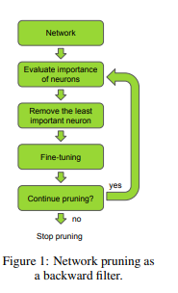


Paper5 Methodology :
1. Evaluate Neural network
2. Obtain new parameters based on backpropagation of the cost function.
3. Use Pruning criteria: Minimum weight, minimum activation values, minimum mutual
Information, Taylor expansion of cost function with and without pruning.
4. Stop pruning after achieving good accuracy or better memory utilization
Taylor Expansion

Slide 16
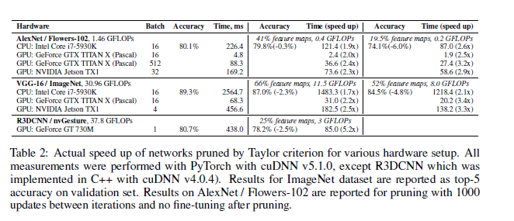
Paper 5 Results:
They prune a trained VGG-16 network with the same parameters as before, except for enabling FLOPs regularization. They stop pruning at two points, 11.5 and 8.0 GFLOPs, and fine-tune both models for an additional five epochs with a learning rate of 10⁻⁴. Fine-tuning after pruning significantly improves results: the network pruned to 11.5 GFLOPs improves from 83% to 87% top-5 validation accuracy, and the network pruned to 8.0 GFLOPs improves from 77.8% to 84.5%.

Slide 17
Paper6
PRUNING FILTERS FOR EFFICIENT CONVNETS
Hao Li, Asim Kadav, Igor Durdanovic, Hanan Samet,
Rational : Reduce computational cost of neural networks by pruning filters of CNNs.
Hypothesis : simple filter pruning techniques can reduce inference costs for neural networks
while regaining close to the original accuracy by retraining the networks.
Datasets: CIFAR-10,IMAGENET
Networks:VGC16,ResNet34, ResNet56,ResNet110

Slide 18
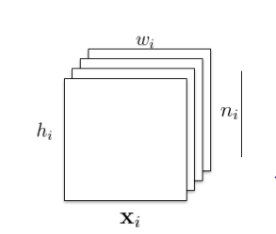
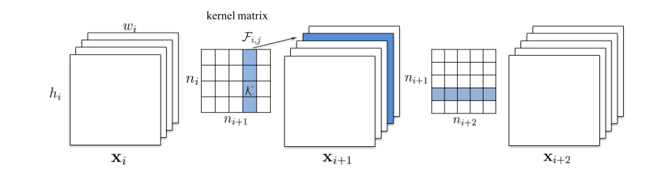
Paper6 Methodology:
Lets assume we have a layer with each feature map as height h_{i} and width w_{i}
We have ni such feature maps
We will create a filter (K) which will have kernel size as k X k and the n_{i+1} dimensions.
For pruning of filters we make a matrix of filters with dimensions ni ( input dimensions ) and n _{i+1} and we select some filters among this matrix of filters to prune.
For Eg : in previous eg we had ni = 3 (RGB) and n_{i+1} = 128. So we might remove one filter among the 128 filters which will be applying on RGB layer of input image.
Now our dimensions become 127. It reduced calculation of that one filter which was going to multiplied by RGB.
Moreover, now since for next layer we have input dimesion of 127. Therefore if n_{(i+2)} is 256. Therefore it reduced the calculations for that one removed filter with next 256 filters.

Slide 19
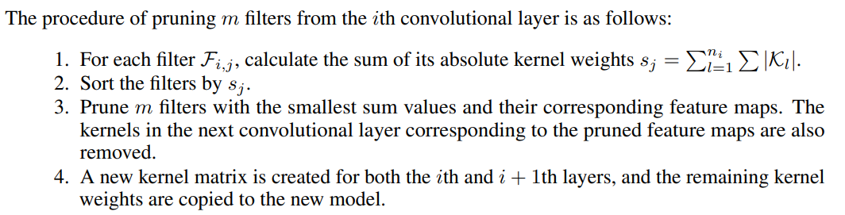
The procedure of pruning m filters from the ith convolution layer is as follows:
Pruning m filters of layer i will reduce m/ni+1 of the computation cost for both layers i and i + 1
Pruning across layers
Prune once and retrain: Prune filters of multiple layers at once and retrain them until
the original accuracy is restored.
2. Prune and retrain iteratively: Prune filters layer by layer or filter by filter and then
retrain iteratively. The model is retrained before pruning the next layer for the weights to
adapt to the changes from the pruning process.

Slide 20
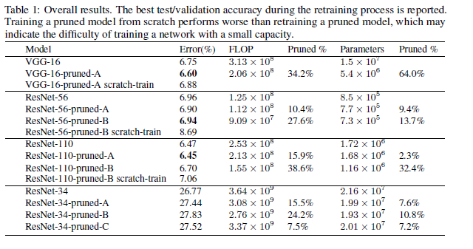
Paper6 Results

Slide 21
Research Problem
Pruning of Neural Network: Lottery Ticket sub-Networks
Rational: Neural network computations require high end Hardware ,consume lot of
time and Energy. Large scale application of Neural networks can be possible if they
could be run on cell phones and laptops, which have limited resources. Efficient
Neural Network pruning can reduce the parameter of networks with high accuracy.
Lottery Ticket Hypothesis for pruning Neural networks without loss in accuracy is
proposed by researchers at MIT,CSAI Lab . Based on this Lottery Ticket approach
pruning methods with different pruning masks ,pruning scores , initialization methods,
algorithms are proposed and studied by many researchers.
Hypothesis : We propose to study different methods of parameters pruning , parameter
masking criteria , methods of initialising remaining parameters to obtain sub network
with good accuracy as original network. The proposed study will be carried out with
different image datasets and convolution neural networks models.

Slide 22
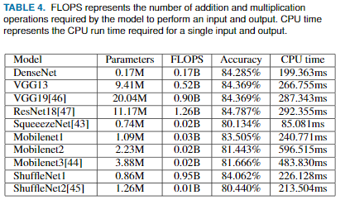
Motivation:
Neural networks have millions of parameters which require billions of Floating point
Operations and high computing processor and memory requirement .A table indicating
Neural network complexity is shown below.
Pruning neural networks can give good results within short time and reduced usage of
computing resources .
Expression Recognition Method Based on a Lightweight Convolutional Neural Network
Ref: DOI10.1109/ACCESS.2020.2964752, IEEE Acces

Slide 23
Methodology:
Datasets:MNIST,CIFAR10
Networks:Lenet5,AlexNet,Conv6,Conv8,VGG19,Resnet18
Procedure:
For each network model the following steps are carried out on each dataset:
A.One Shot Pruning:
1. Randomly initialize a neural network parameters as θ_{i.}
Train the network for j iterations, arriving at new parameters θ_{f}.
Prune p% of the parameters in θ_{j}, based on the following Mask
criteria:large final (|w_{f}|), Magnitude increase(|w_{f}|-|w_{i}|)
4. Reset the remaining parameters to their initial values in θ₀,calculate accuracies
to find winning sub network.
B . Iterative Pruning:
The above procedure repeated for n iterations, p^{1/n}% parameters of the previous
iteration are pruned.

Slide 24
One Shot Pruning Flow Chart:
Start
Init Weights from trained model
Select best subnetwork among the j pruned subnets
Is i=j?
yes
End
no
Prune p% weights on mask criteria
Initialize remaining weights to initial values
Evaluate Network Accuracies
Pruning criteria:large final (|w_{f}|), Magnitude increase(|w_{f}|-|w_{i}|)

Slide 25
Iterative Pruning Flow Chart:
Start
yes
Is i=n?
Select best subnetwork among the n*j pruned subnets
End
no
Init Weights from trained model
Is i=j?
yes
no
Prune p^{1/n}% weights on mask criteria
Initialize remaining weights to initial values
Evaluate Network Accuracies
Pruning criteria:large final (|w_{f}|), Magnitude increase(|w_{f}|-|w_{i}|)

Slide 26
Research Management Plan:
Each member will implement :
one shot pruning and Iterative pruning on one of the
networks:Lenet5,AlexNet,Conv6,Conv8,VGG19,Resnet18
2. one shot pruning and Iterative pruning on one of the network for both
MNIST and CIFAR10 datasets.
3.Evaluation of each Neural networks will be done .
4.Plots for Accuracy vs different masks ,datasets and networks will be plotted.
Team Work:
5.From evaluation and plots best sub network with comparable accuracy to original
Network will be inferenced.

Slide 27
Feasibility & Risk :
1.We envisage to use Tensorflow library which supports programming to save Models,
get and set layer wise weights and biases. These features can be used for network weights
initialization , masking and pruning.
2.The proposed project can be implemented for Small Epochs. For high epochs like 112000
large computing resources are required. Original paper used IBM-WATSON AI LAB
computer resources.
3.The proposed project can be implemented on small datasets(MNIST,CIFAR10).Cannot be
implemented for large datasets(ImageNet), as huge computing resources are required.
4.For this project implementation large training times and huge memory resources are required.

Slide 28
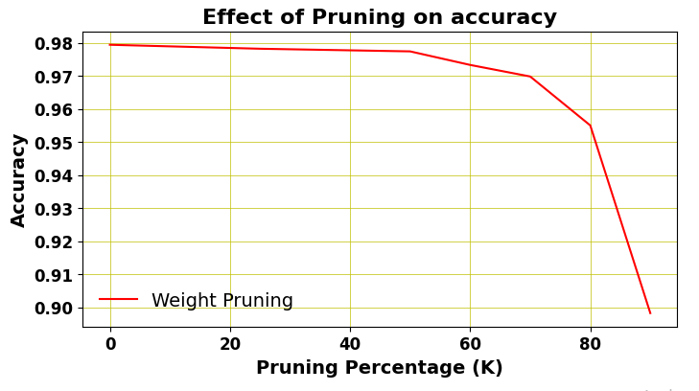
Preliminary study:
A small prototype code for Weights pruning is implemented for dense layer network.
The accuracy graph for pruning percentage is shown below. Up to 60 percent pruning
there is no considerable decrease in accuracy . Mask criteria of pruning percentage of weights
is used . No re-initialization of weights is used.

Slide 29
THANK YOU

